Slide 1
Data Structure and Types

Slide 2
Data
Quantities, characters, or symbols on which a computer performs operations.
It may be stored and transmitted in the form of electrical signals and recorded on magnetic, optical, or mechanical recording media.
E.g.: c = a+b, here a and b can be thought of as data

Slide 3
Difference between data and information
E.g.: Data: TEERPSAJ SI EMAN YM
Information: MY NAME IS JASPREET
Data - merely a collection of characters, and from this, the user cannot understand anything properly.
When this data is processed, then it become an information because now the user can read, understand, and extract some meaning from it.
If data is arranged systematically, then it gets a structure and becomes meaningful.
This meaningful or processed data is called information.

Slide 4
Data Structure
A data structure is a systematic way to organize data so that it can be used efficiently in terms of time as well as space.
It is also used for processing, retrieving and storing data.
There are different basic and advanced types of data structures that are used in almost every program or software system that has been developed, so we must have good knowledge about data structures.
Depending on our requirement and project, it is important to choose the right data structure for our project.

Slide 5
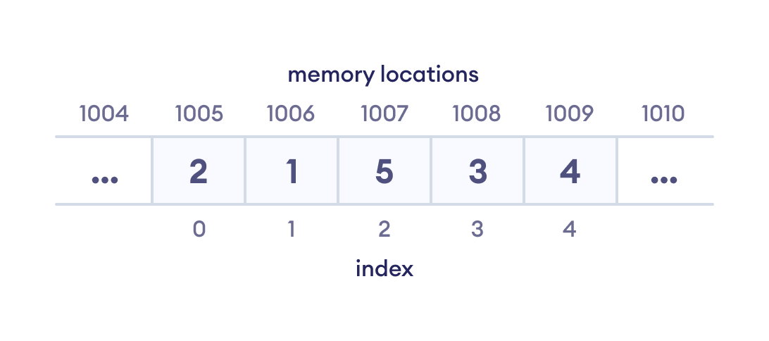
E.g.: if we want to store data sequentially in the memory, then we can go for the array data structure

Slide 6
Need For Data Structures
Data needs to be managed in such a way so that it can produce some meaningful information.
To provide an appropriate way to structure the data, we need to know about Data Structures.
Data structures give us the way to manage the data appropriately so that we can use it effectively whenever possible.
We can efficiently use space and time [e.g.: library]

Slide 7
Data Types
It defines a certain domain of values and operations allowed on those values.
E.g. 1: int data type
It takes only integer values.
We can perform almost every operation on integer type.
E.g. 2: float data type
It takes only floating-point values.
Operations allowed on float data type: addition, subtraction, multiplication, division, etc.
Bitwise and %% (modulus) operations are allowed on the int data type but not on the float data type.

Slide 8
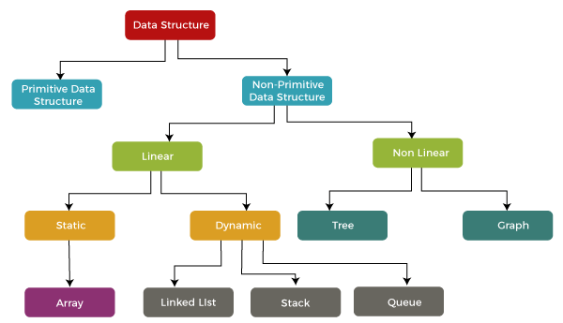
Types of Data Structure
Fig: Classification of Data Structure

Slide 9
Linear data structures
Elements are arranged in sequence one after the other.
So, they are easy to implement.
When the complexity of the program increases, this might not be the best choice because of operational complexities.
They are of two types:
1. Static data structure:
fixed memory size.
easier to access the elements.
2. Dynamic data structure:
the size is not fixed.
It can be randomly updated during the runtime which may be considered efficient concerning the memory complexity of the code.

Slide 10
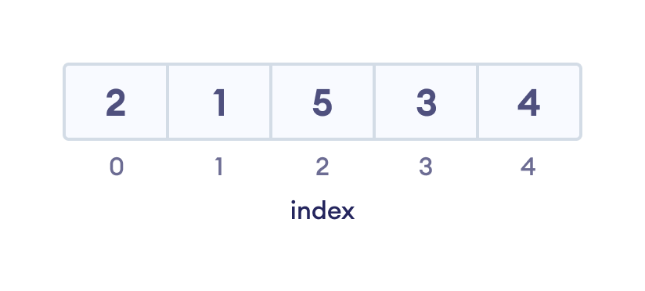
Array Data Structure
Here, elements in memory are arranged in continuous memory.
All elements of an array are of same type.
And, the type of elements that can be stored in the form of arrays is determined by the programming language.
Fig ii: Array data Structure

Slide 11

Example: Arrays are used to store an image as a bitmap.
Bitmap images are a series of tiny dots called pixels.
Fig vi: Image of Pikachu (37 x 40)

Slide 12
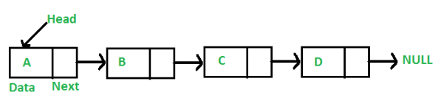
Linked List Data Structure
Here, data elements are connected through a series of nodes.
And, each node contains the data items and address to the next node.
In simple words, a linked list consists of nodes where each node contains a data field and a reference (link) to the next node in the list.
Fig v: Linked List Data Structure

Slide 13
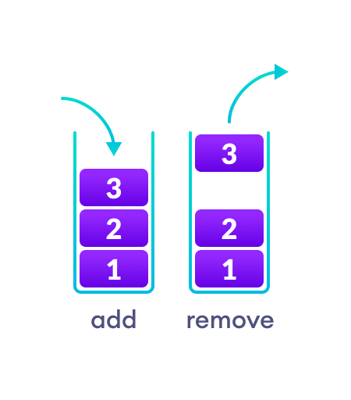
Stack Data Structure
Here, elements are stored in the LIFO principle i.e., the last element stored in a stack will be removed first.
It works just like a pile of plates where the last plate kept on the pile will be removed first.
push(): Insert an element into the stack
pop(): Delete or retrieve an element from the stack
Fig iii: Stack Data Structure

Slide 14
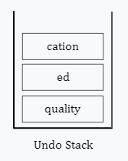
Examples of Stack Data Structures
Example 1: Stack data structure is used in implementing redo and undo features.
TEXT: The primary goal of Softroniics is to give quality ed cation
Fig i: Initial State of Undo Stack
In fig i, instead of education, we have written edcation which we can correct by undoing the last performed operation. This is possible because these data are stored in the undo stack.

Slide 15
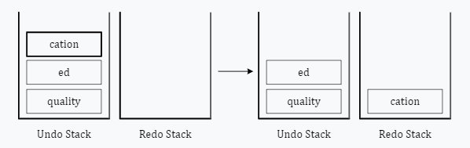
When we undo (CTRL+Z) , the top element from the undo stack, i.e., cation, is selected and placed in the redo stack. Thus, cation gets removed from the text. See the following figure.
TEXT: The primary goal of Neso Academy is to give quality edcation
Fig ii: Undoing cation
A redo stack is required in case the user wants to redo the operation. If we like to place cation back again, then we can redo (CTRL+Y), and the top element of redo stack, i.e., cation will be placed back again. Similarly, after correcting education, we can continue writing:

Slide 16
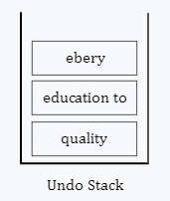
Contd..
TEXT: The primary goal of Neso Academy is to give quality education to ebery
Fig iii: Updated Undo Stack

Slide 17
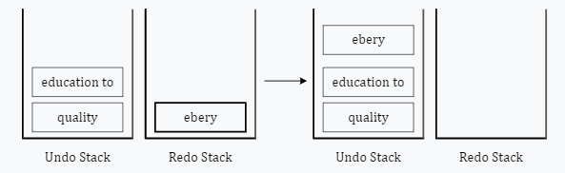
Contd..
Operation: Redo (CTRL+Y):
TEXT: The primary goal of Neso Academy is to give quality education to ebery
Fig v: Redoing ebery

Slide 18
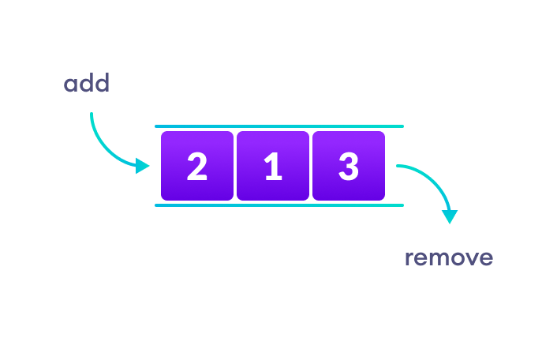
Queue Data Structure
Unlike stack, the queue data structure works in the FIFO principle where first element stored in the queue will be removed first.
It works just like a queue of people in the ticket counter where first person on the queue will get the ticket first.
In a queue, addition and removal are performed from separate ends.
Fig iv: Queue Data Structure

Slide 19
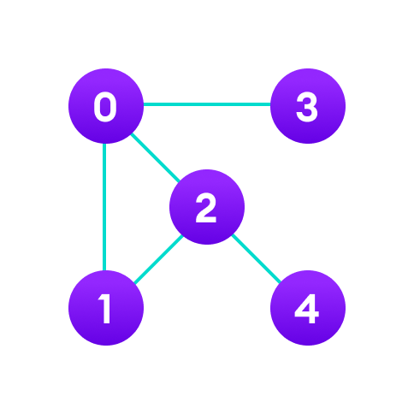
Graph Data Structure
Here, each node is called vertex and each vertex is connected to other vertices through edges.
Fig: Graph Data Structure

Slide 20
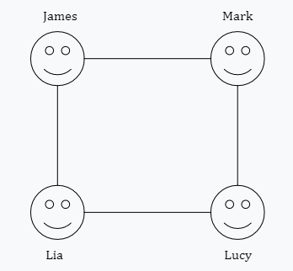
Example 3: Storing the friendship information on a social networking site.
Fig vii: Graphical Representation of Social Networking Site
Here, James is a friend of Mark and Lia.
Also, Lucy is a friend of both Mark and Lia.

Slide 21
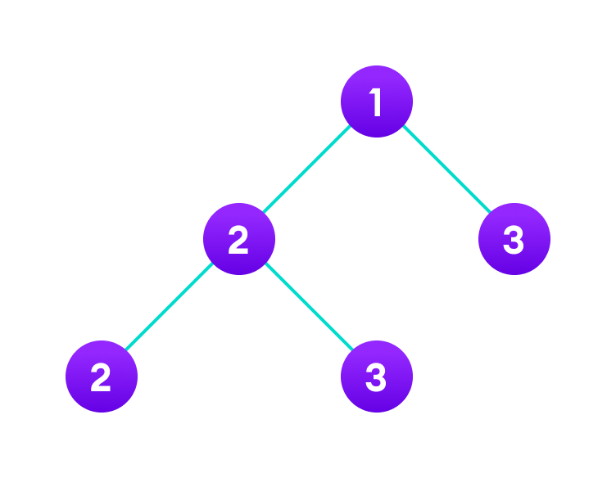
Tree Data Structure
Similar to a graph, a tree is also a collection of vertices and edges. However, in tree data structure, there can only be one edge between two vertices.
Fig: Tree Data Structure

